Slide 1
Understanding Individual Behavior and Motivation

Slide 2
Motivation
0
One secret for success in organizations is motivated and enthusiastic employees
The challenge is to keep employee motivation consistent with organizational goals

Slide 3
Motivation
0
Arousal, direction, and persistence of behavior
Employee motivation affects productivity
Part of a manager’s job is to channel motivation toward the accomplishment of organizational goals

Slide 4
Two Types of Rewards
0
Intrinsic rewards--satisfactions a person receives in the process of performing a particular action.
Extrinsic rewards--given by another person.

Slide 5
A Simple Model of Motivation
0
NEED-Creates desire to fulfill needs (food, friendship, recognition, achievement).
BEHAVIOR-Results in actions to fulfill needs.
REWARDS-Satisfy needs; intrinsic or extrinsic rewards.
FEEDBACK-Reward informs person whether behavior was appropriate and should be used again.

Slide 6
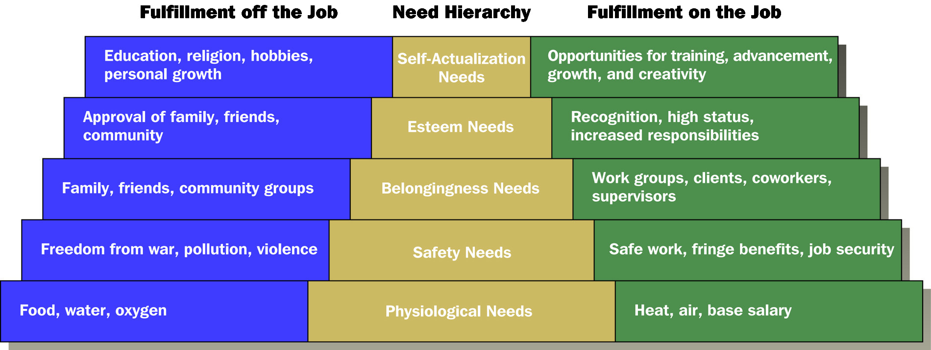
Maslow’s Hierarchy of Needs
0

Slide 7
Maslow’s Hierarchy of Needs
0
Once a need is satisfied, it declines in importance and the next higher need is activated
There are opportunities for fulfillment off the job and on the job in each of the five levels of needs
Clayton Alderfer’s – Frustration Regression Principle

Slide 8
Process Theories of Motivation
0
Equity Theory
focuses on individuals’ perceptions of how fairly they are treated compared with others
motivated to seek social equity in the rewards they expect for performance

Slide 9
Methods for Reducing Perceived Inequities
0
Change inputs
Change outcomes
Distort perceptions
Leave the job

Slide 10
Process Theories of Motivation
0
Expectancy Theory
motivation depends on individuals’ expectations about their ability to perform tasks and receive desired rewards
concerned not with identifying types of needs but with the thinking process that individuals use to achieve rewards
based on the effort, performance, and desirability of outcomes

Slide 11
Goal Setting Theory
0
A motivation theory in which specific challenging goals increase motivation and performance when the goals are accepted by subordinates and these subordinates receive feedback to indicate their progress toward goal achievement.

Slide 12
Reinforcement Perspective on Motivation
0
Positive reinforcement in the administration of a pleasant and rewarding consequence.
Avoidance learning is the removal of an unpleasant consequence following a desired behavior.
Reinforcement
Tools
Punishment is the imposition of unpleasant outcomes on an employee.
Extinction is the withdrawal of a positive reward, behavior is no longer reinforced and hence is less likely to occur in the future.

Slide 13
Job Design for Motivation
0
Job design = application of motivational theories to the structure of work for improving productivity and satisfaction
Job simplification = job design whose purpose is to improve task efficiency by reducing the number of tasks a single person must do

Slide 14
Job Design for Motivation
0
Job Rotation = job design that systematically moves employees from one job to another to provide them with variety and stimulation
Job Enlargement = job design that combines a series of tasks into one new, broader job to give employees variety and challenge

Slide 15
Job Design for Motivation
0
Job Enrichment = job design that incorporates achievement, recognition, and other high-level motivators into the work
Work redesign = altering of jobs to increase both the quality of employee’s work experience and their productivity

Slide 16
Individual Behavior
Intra-role behaviors
Behaviors that individuals engage in to fulfill their contract of employment
Organizational citizenship behaviors
Behaviors that benefit the organization but go beyond what is required or expected
Absenteeism
The failure to show up for work

Slide 17
Individual Behavior (cont’d)
Turnover
Consists of individuals leaving the organization and having to fill the empty position
Counterproductive behaviors
Voluntary behaviors that may harm the organization by negatively impacting its resources in a way that reduces performance

Slide 18
Big Five Personality Traits
Personality refers to the pattern of thoughts, emotions, and behaviors that a person exhibits.
The Big Five factors of personality seek to condense the many traits into the most important dimensions.
Conscientiousness
Agreeableness
Emotional Stability (Neuroticism)
Openness to Experience
Extroversion

Slide 19
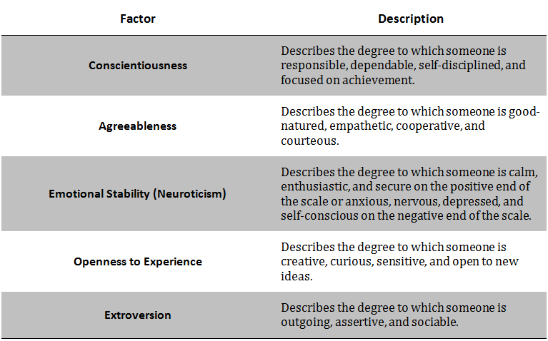

Slide 20
Perception
Perception is the process by which we strive to make sense of the environmental stimuli surrounding us.
Ignoring common stimuli (typing on a keyboard, humming of an air conditioner, employees chatting,) is called selective attention, perceptual selectivity.

Slide 21
Perception (cont’d)
Several factors may affect the interpretation of stimuli, such as:
Past experience
Personality
Attitudes
Values
Expectations
Social groups
How might each of these factors affect what events we perceive and how we perceive them?

Slide 22
Perceptual Biases
Stereotyping
Assigning traits to people based on observable characteristics or membership in a social category
Attribution Theory
Understanding the cause or causes of events
Uses three rules: consistency, distinctiveness, and consensus

Slide 23
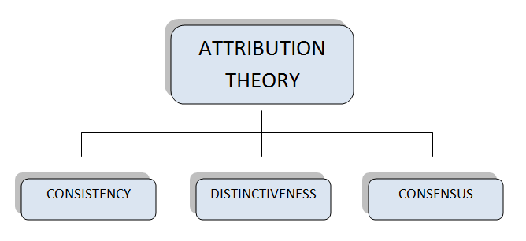

Slide 24
Attribution Theory
Consistency
Is the behavior consistent with other behaviors that the individual has exhibited in the past?
Distinctiveness
Is the behavior by an individual distinct from behavior in other situations?
Consensus
Do other people exhibit the same behavior?

Slide 25
Fundamental Attribution Error
About others
Too much emphasis on internal factors and too little emphasis on external factors
For example, if a line worker on an automobile manufacturing line makes a number of mistakes in installing steering wheels, the manager is more likely to initially attribute the errors to poor effort or ability than to poor lighting or tools.

Slide 26
Self Serving Bias
About our selves
Over-emphasize external factors
Under-state internal factors

Slide 27
Locus of Control
External – Environmental
Internal – Determine our own fate

Slide 28
Other Perceptual Biases
Primacy Effect
Developing a judgment or opinion about a person based on the initial perception of that person
Recency
Most recent observation is what we judge the person by
Halo effect
Allowing a single perception to influence the perceptions of other characteristics
Projection bias
Assuming others share our own thoughts, feelings, values, motivations, and behaviors

Slide 29
Attitudes
Attitude consists of the thoughts, emotions, and behavioral intentions towards objects or people.
Many factors influence attitude, including family life, job satisfaction, organizational commitment, etc.
When attitudes and associated behavioral intentions are relatively good predictors of behavior, they are not always consistent. This is called cognitive dissonance.

Slide 30
Stress
Stress is an adaptive response to the pressures of a situation that is perceived to be challenging or threatening to the individual’s well-being.
Interpersonal stressors result from the daily interactions with people.
Role-related stressors refer to pressures from a particular role in an organization.
Managers should create an environment that minimizes stress.
What types of things do you do to relieve stress?

